Slide 1

Geographical Distribution of Four Extinct Carnivoran Families
Canids (dogs), Felids (cats), Ursids (bears), and Hyaenids (Hyenas)
Elizabeth Linville
Notes:
Good evening and welcome to this presentation about the Geographical distribution of four carnivoran families. Specifically, this project looked at the Canidae (or dogs), Felidae (cats), Ursidae (which are your bears) and the Hyaenidae (which you guessed it – the hyenas).

Slide 2
Part I – Data Exploration
Data Source, Variables, Specimen Representation
Notes:
So in this first part of the presentation we will take a look at the source of the data, the initial questions that I came up with for this project, and we will take a look at some of the key variables that were used in the analysis.

Slide 3

Overview of Project
This data set is derived from the online open database for fossil occurrences, known as the Paleobiology Database
Initially contained over 11,000 specimen entries with 29 variables
This was filtered down to look at only four families contained within the Order Carnivora
Notes:
So at the start of this project I knew I wanted to delve back into my roots in paleontology just to see how it was different using a “big data” approach. Instead of sitting in a dusty lab after traveling the nation collecting specimens, I was able to just jump on to this Paleobiology Database and download information for literally thousands of fossil specimens. What would have taken me years to do, I did in seconds. There was actually so much information that I had to slim it down! I initially chose the order Carnivora, or mammals that typically eat meat, because I wanted a large data set. Then I realized this is actually too big of a set, a problem I never thought I’d come across working with fossils. So then I dwindled it down to my four favorite predatory families: dogs, cats, bears, and hyenas.

Slide 4

Initial Project Questions
1. How does the distribution of four main Carnivoran families (Canidae, Hyaenidae, Felidae, and Ursidae) change over time?
2. Are the populations directly or inversely proportional to one another?
3. Does the geographic range change for each family individually over time and why?
4. Were potential competition rates an influence in the distribution of these families?
5. Is one family more represented in the fossil record than others?
6. Which family has the most extinct biodiversity according to the fossil record?
7. Where, geographically, were there potential interactions between members of these four families?
8. How can the interaction and geographic distribution of these organisms give information for today's declining biodiversity?
Notes:
Although I had eight initial questions, we will just focus on a few here. Feel free to read through the list, but particularly this project was aimed at looking at geographical distribution variances between these families over time. I wanted to know how the ranges for each group changed over time, and potentially why, while keeping ecological interdependence relationships in the back of my mind. I also wanted to test some notions that I developed in earlier academic ventures and see how the diversity of each family fared and again changed over time. I felt that these were questions that could be tested using this data set and the skills we have developed in this course.

Slide 5
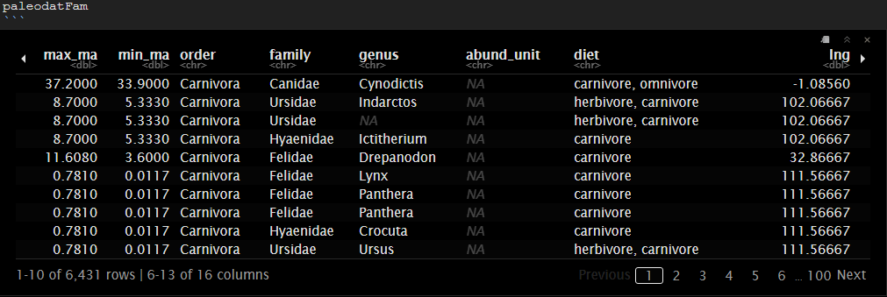

Variables at-a Glance
Some of the variables were eliminated from the project
Others were created to contain more relevant information
Mostly categorical
Notes:
The dataset originally had 29 columns, or variables, but many were not useful for data analysis. So some were eliminated, like comments on where the fossil was found, the state and town it was found in, etc. Because most of my data was actually categorical, as in taxonomic identifications, and other biological markers like diet, I had to create a few new variables. Although I was provided with the time frame in which the fossil was found (the max_ma and min_ma variables) I wanted to make an easier way to reference the time. So, using the geologic time scale as a reference, I organized the max_ma variable into time ranges that correlate with specific epochs within geologic time. This makes it more clear to analyze the patterns that may occur in geographical distribution over time.

Slide 6
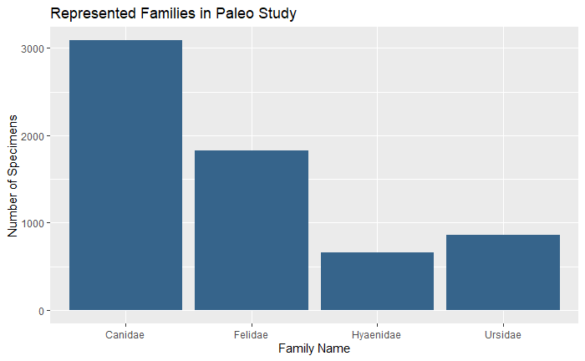
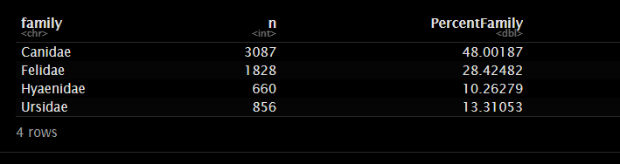

Specimen Representation
In this dataset, the Canidae family (dogs) was the most represented taxa, with Hyenas being the least represented fossil specimens
Notes:
In the initial exploration, one of the first plots that I focused on was graphing the representation of each family. As shown by both the ratios here in the table and the associated visualization, the canid family makes up almost half of the entire data set. Felids are another large population contributing nearly 30% of specimens, and the bears and hyenas trail considerably behind in representation. Immediately, I was pretty surprised how far behind these two families were. This of course, generated more questions. This may be a reflection of population dynamics. It is also important to note that the Hyaenidae family was the last to come to the party, so their overall lower numbers may be a representation of this fact. You would expect though, a greater diversification in the time that they were present - were competition levels an issue? Or is this a case of ecosystems lacking the appropriate conditions for fossilization and preservation?

Slide 7
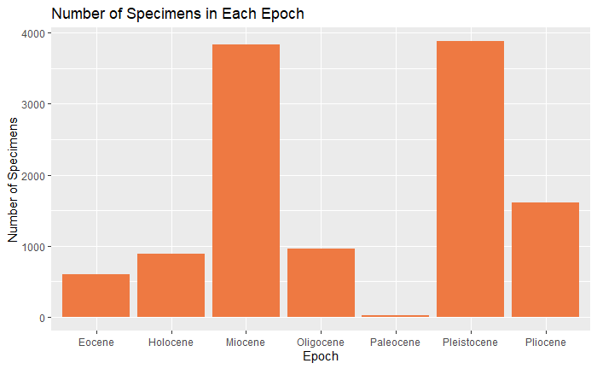
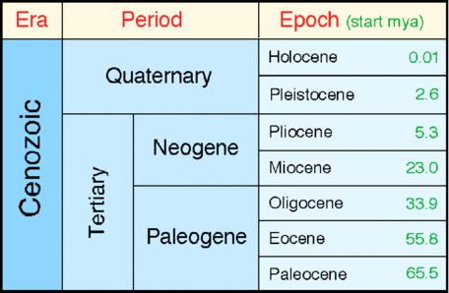
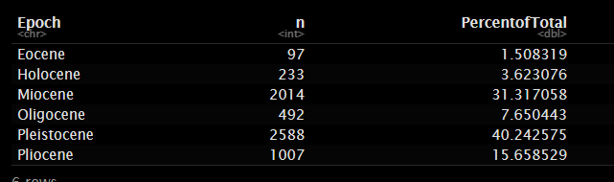
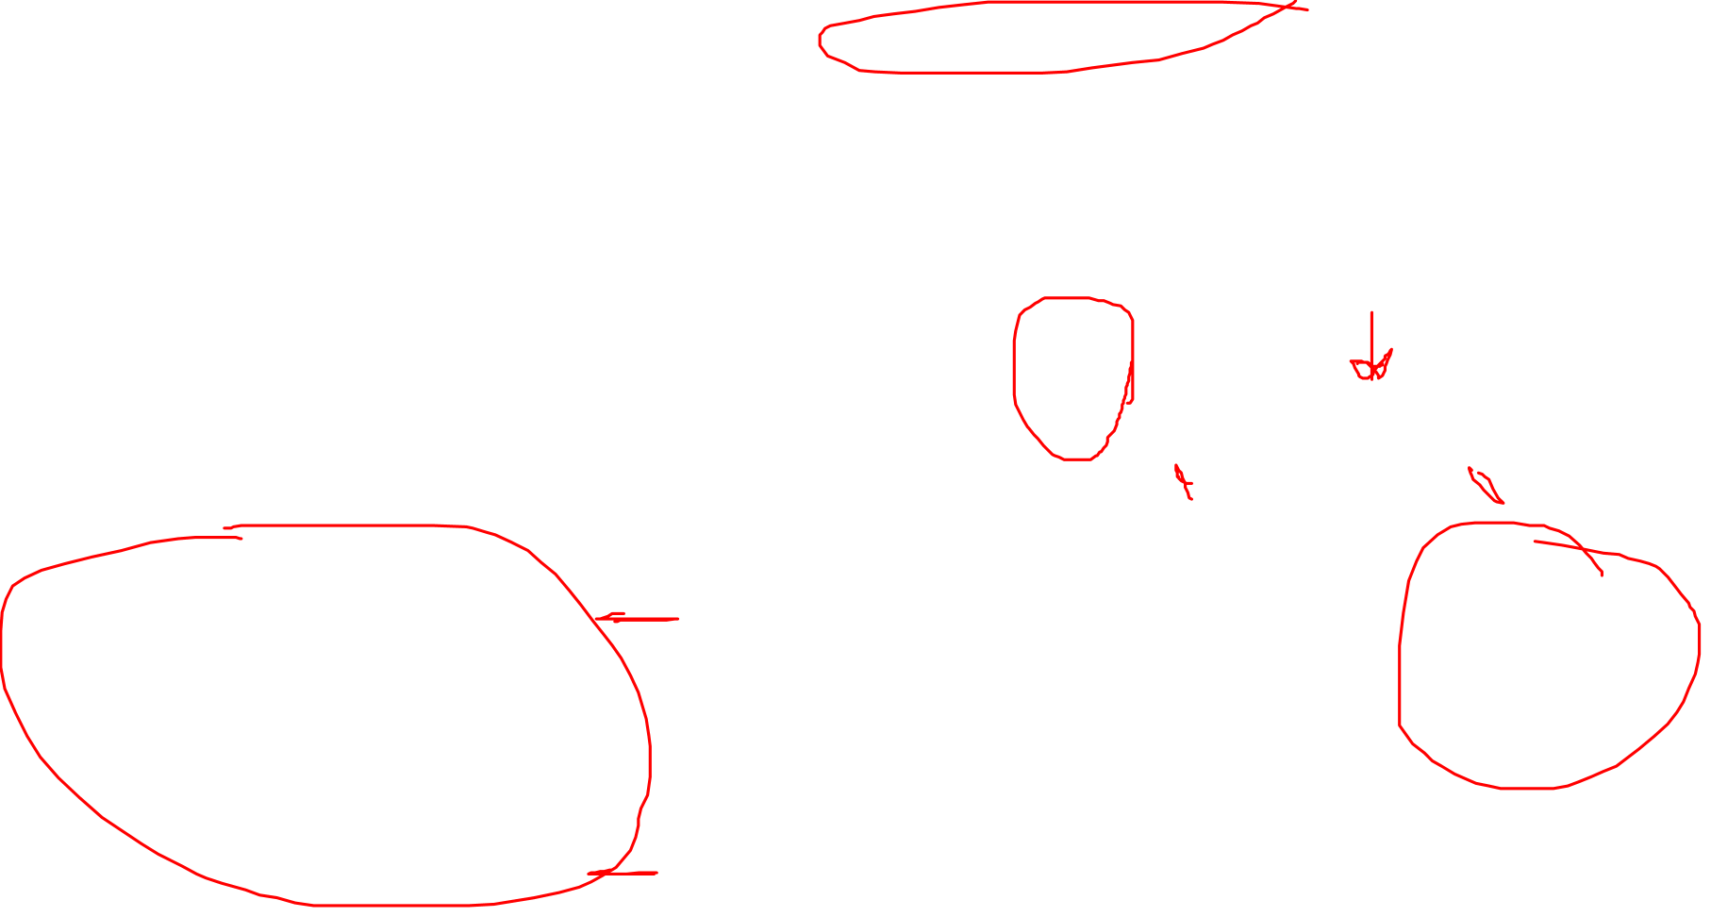
Time Scale Representations
Since mammals are best represented in the Cenozoic Era, I decided to break this down into the accepted Periods and Epochs
Notes:
Following the general count representations, I decided to see which epochs had the greatest representation of specimens. I included a snapshot of the geologic time scale highlighted the time we are focused on here. Known as the Cenozoic Era, or Age of Mammals, it is broken down into seven epochs. The Paleocene is the oldest and begins after the massive extinction of the dinosaurs. The most recent is the Holocene. Looking at the data on this slide, we can see that the Pleistocene and Miocene had the greatest representation of organisms, whereas the Paleocene has the lowest (this is not surprising since mammals just started to evolve into modern-day families during this time). The Pleistocene includes the “last Ice Age” where there was great diversification in various megafauna, so it is not surprising that this is a well-represented epoch. Sadly, though, after the massive extinction event at the end of the Ice Age, it seems that populations have failed to rebound to prior levels, and the Holocene is one of the more poorly represented time periods in terms of fossil remains and diversification.

Slide 8
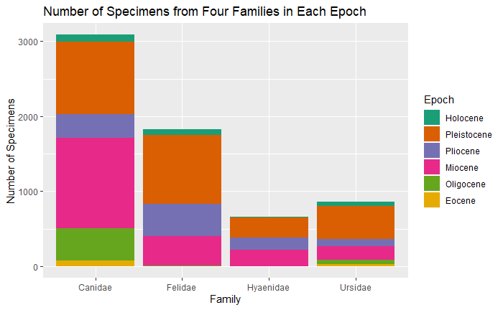

Notes:
In order to combine the information from family and epoch, I decided to create a stacked bar graph. This initially gave me some trouble to get the order to match the chronological order of the time epochs, but I think it works well to demonstrate the differences in fossil representation between the four families.

Slide 9
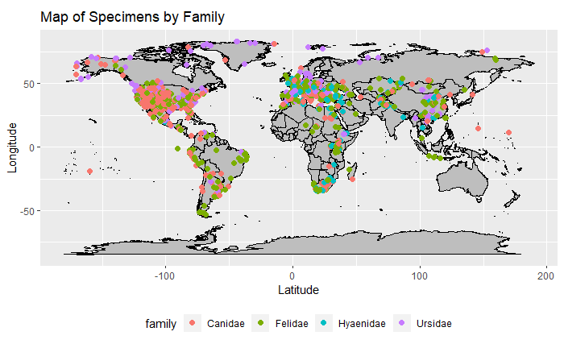
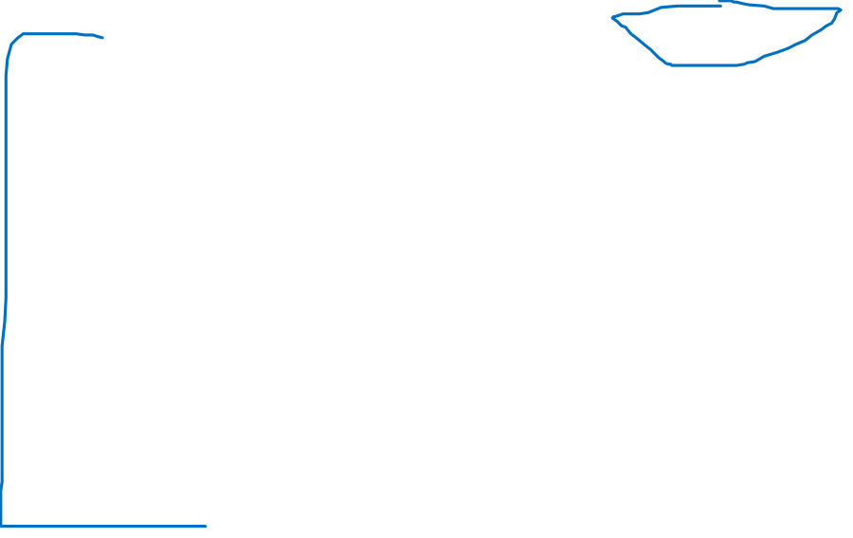
Geographic Distribution of Families
Notes:
Finally, I decided to actually plot the distribution of the fossils based on the lat and long coordinates that were provided with the data set. Distribution varies based on the family. For example, it seems that the Canids, Felids, and Ursids are heavily concentrated in North America and Europe, with some distribution in South America, Africa, and Asia. Interestingly, bears are pretty poorly represented in Africa and South America, at least based on this data set. Hyenas are concentrated only to Africa, Europe, and Eurasia, with no representation in the Americas. More on this later – but this concludes the Part I aspect of this project.

Slide 10
Part II – Finding Meaning in the Data
Deeper Exploration and Statistical Analyses
Notes:
For Part II, I wanted to go a little deeper into the meaning behind the initial exploratory data. Specifically, my goals were to run some stats that are typically used in ecology to look at population richness and diversity, as well as plot the geographic distribution for each time period and overlay them to see how these populations changed.

Slide 11
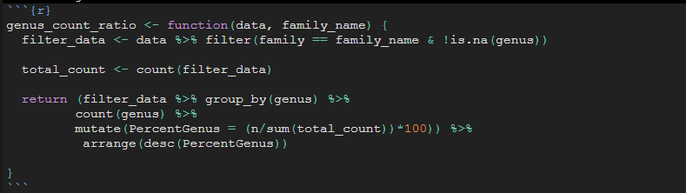

Analysis of Genus Representation
For each family, I was curious about which genus members were more represented. I wrote a function that filtered the data and returned the total count for each genus in each family, as well as the percent ratio.
Notes:
In order to better understand the relationships and distribution of each family, I decided to subset my data and focus on the genus level of taxonomy. This allows me to get more specific to see what members of each family are being represented by the fossil record. To do this, I had to write a function that filtered out the genus level information for each family, but then returned ratio so I could figure out which genus was best represented.

Slide 12
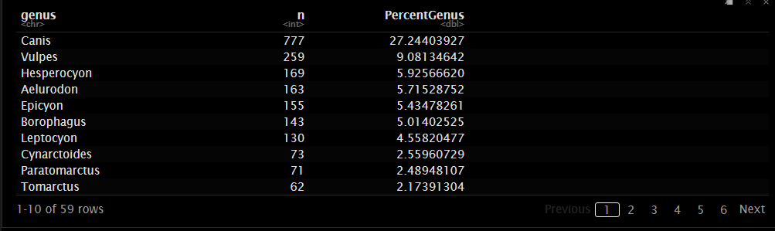
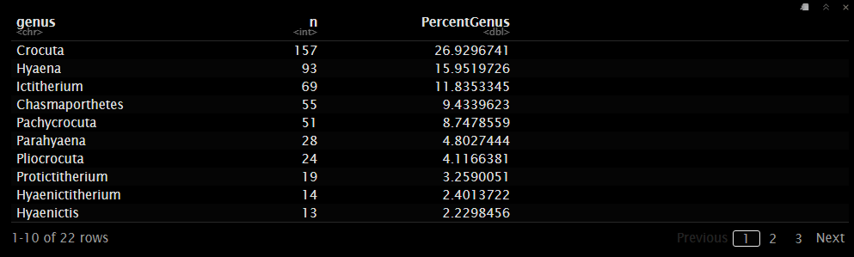

Notes:
Here is an example of what was returned from the function. It lists the genus percentage and the count of how many specimens have been identified. So here, for the top Canidae family example, the genus “Canis” is the most represented, with almost a third of all specimens being from this common genus. This includes wolves, coyotes, etc. For the Hyenas, we can see that again a third of the representation is from a modern genus, Crocuta, which includes the modern Spotted Hyena, but also some really large and terrifying extinct members.

Slide 13

Statistical Modeling
Other than ratios, some additional statistical modeling was completed for this dataset
ACE function – Abundance Based Coverage Estimator (species richness)
Chao2 function – Estimation of species richness and diversity
Using the ACE and Chao2 statistical functions, I was able to get a general idea of the species richness for each family based on the specimen evidence from the fossil record. This allows us to better understand more accurate population densities of each genus.
Notes:
When I first started this project, I knew I wanted to use a model to estimate the real population numbers based on the fossil specimens. Not all animals become a fossil, so what we find in the fossil records are just snippets or small representations of the population that actually existed. Having a more accurate estimation of the real population sizes of extinct species can give more understanding to environmental and ecological relationships that were occurring. I also knew I wanted to use some ecology-based statistics to better understand the relationship between these families. I found a couple of papers that already did this, and tried to work through the functions and the code that they provided in their supplemental portions, but it was very difficult. After some more research, I found a package that contains all of the stats that can be used in this instance, so that is what I am going to try to use on my data. Lucky for me, this package was just released on March 23 of this year, so it is great timing!

Slide 14
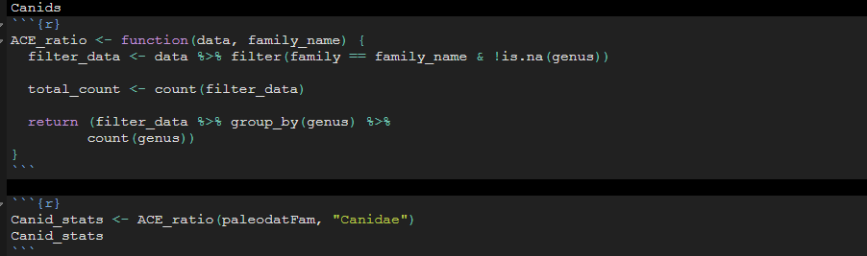
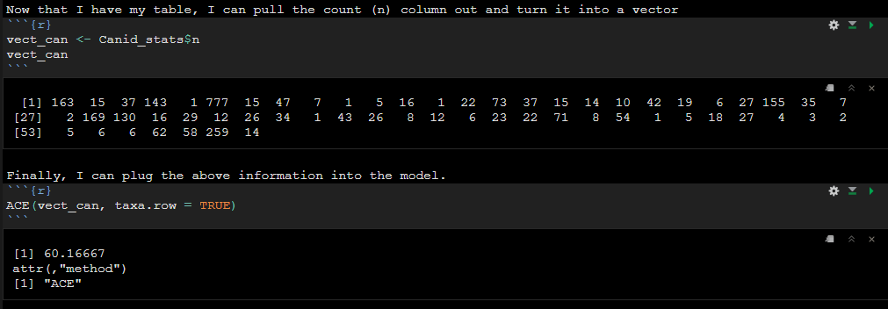
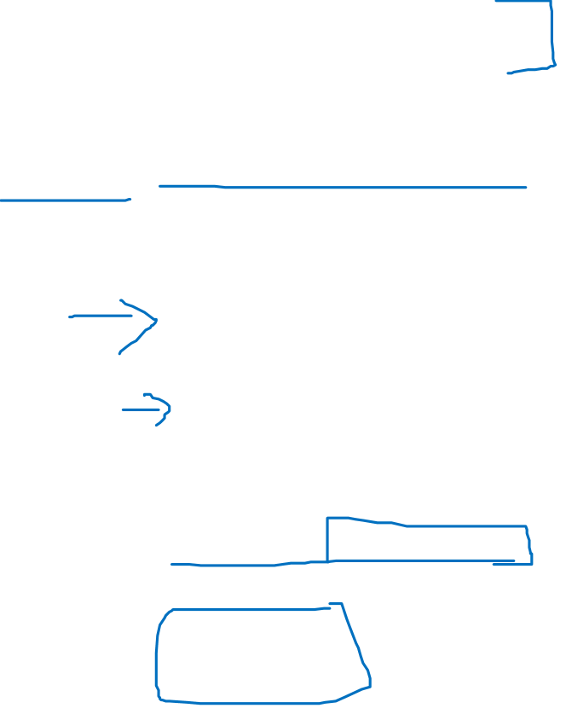

Slide 15
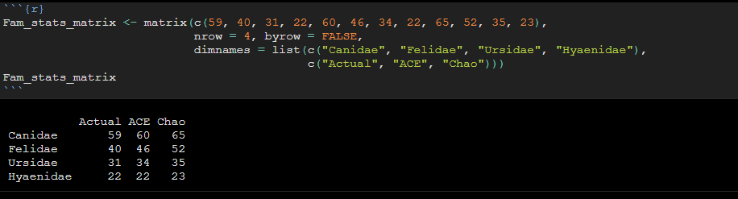

Statistical Results in a Matrix
A matrix was built to better show the results of each of the statistical tests.
Notes:
After I ran each of the models, I created a matrix to display the information. I included the actual data in the fist column (or how many unique entries for each family), then the ACE gives a conservative estimate on how many there may have been, and the Chao gives a more higher-end estimate. Regardless, you can see that the numbers are actually pretty similar. Without running additional statistics and breaking down the data further, one could start to assume that the fossil record for these families based on this data, during the given time periods gives a potentially accurate reflection of the species diversity and richness. The results are probably more similar to the actual numbers for bears and hyenas because of the smaller sample size for these two groups.

Slide 16
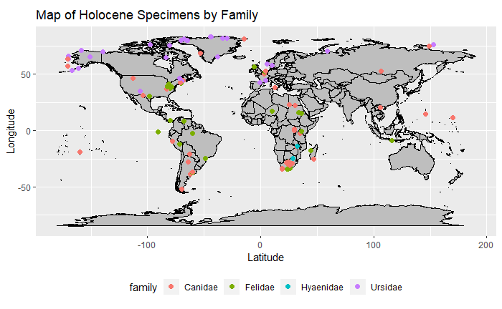
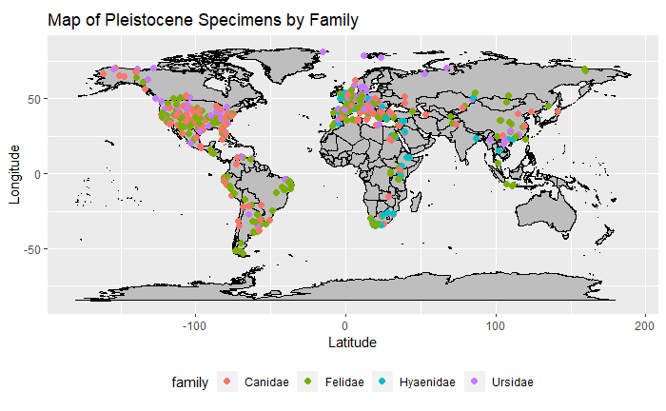
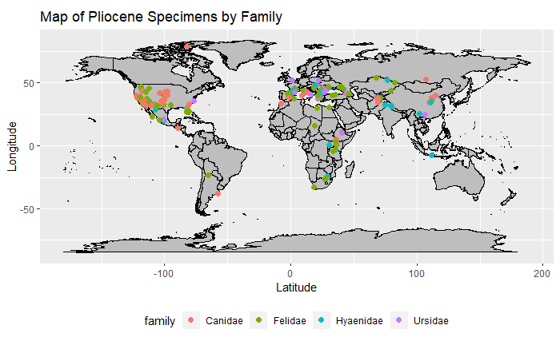
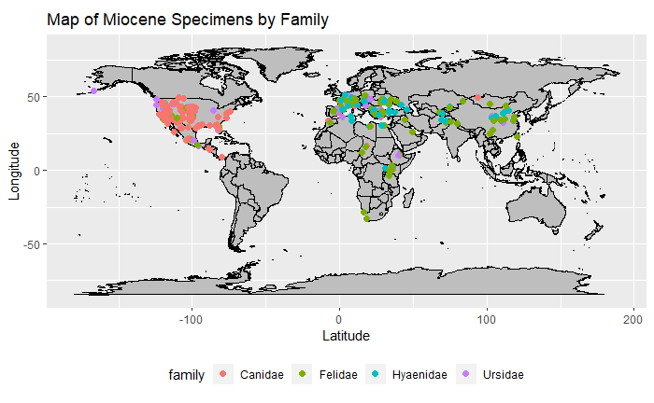
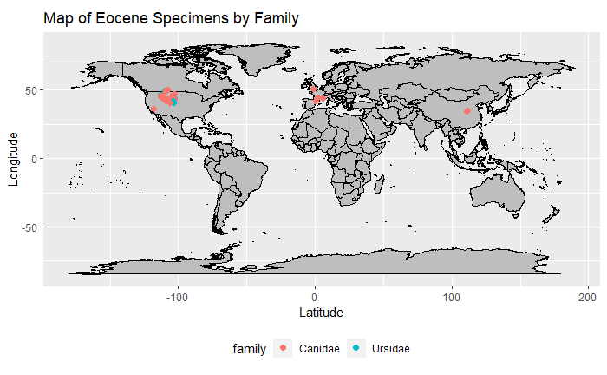
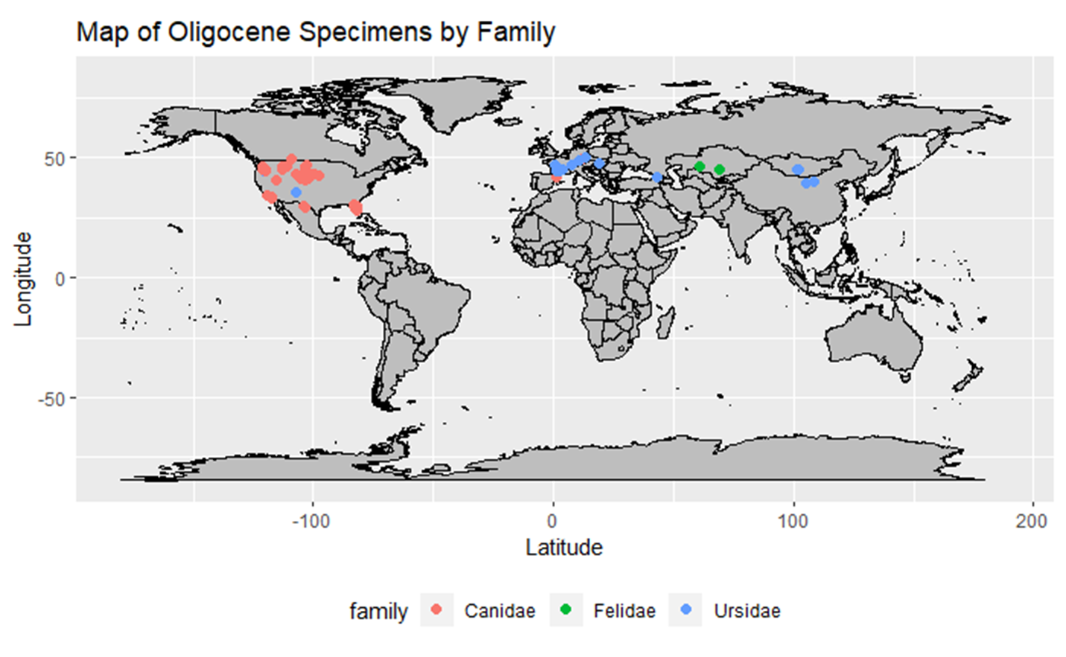
Changes in Geographic Distributions
Notes:
This was really interesting because this follows the well-accepted notion that new species or even families start in small clusters before diversifying and then spreading outward. This pattern is being represented by the data here – groups are starting in more small isolated clusters before radiating outward over time.

Slide 17
Conclusion
How can we better understand modern population dynamics by analyzing changes in fossil populations?
Notes:
Other than this being just cool and interesting, typically, paleontologists have a more applicable point to their research. In this case, I wanted to know how understanding historic populations could help save our modern, struggling diversity for each of these four families.

Slide 18

Important Questions
One of my more important questions was focusing on how we can use this information to understand the pressures that are currently acting on modern populations of these four families.
Notes:
You can see based on the map above that the representation of each family in the Holocene, or modern-day time period, is starkly different than previous time periods. Populations have become quite isolated, occurring only in small geographic pockets. This is represented even today when comparing this map to modern day distribution patterns of these families. Perhaps the focus for conservation should be on what factors after the extinction of the Pleistocene initially caused these families to become isolated, which is only being exacerbated by current pressures from humans. Or was it humans and climate change all along? And we are just seeing the continuation of these factors playing out on these populations? These questions beg more research, of course, but I think this data may prove that something is going on here.

Slide 19

Overall Conclusion
How can the interaction and geographic distribution of these organisms give information for today's declining biodiversity?
The statistics that were run on the species richness and biodiversity indicate that the data set contained a close representation of what was existing for these families over the given time periods.
Unfortunately, the species diversity has declined since the Pleistocene, with only 14 different genera for the Canids (34 total species), 14 genera for the Felids (41 total species), five genera for the bears (only 8 species), and with only three genera for hyenas. This is a large decline in biodiversity in comparison to historical data.
With numbers continuing to decline, as many members of these families are on the IUCN watch list, the overall outlook for these families seems bleak. It is important to look at how such species-dense areas functioned in Earth's past to try to better understand the environmental pressures felt by different populations. This is one step to creating better conservation plans that can appropriately accommodate the needs of the wild animals as well as the necessities of the human populations that are coexisting with them.
Notes:
Overall, I really enjoyed this project and its process. It was exciting for me to get back into a scientific mindset, setting out with some questions and determining the ways to best find those answers. Although using code to do it was an entirely new experience for me, I know see how much of an asset this approach is. Things that I did for this project took only seconds with so much of a larger data set in comparison to my thesis project, which took months (or years) to complete with only a small data set. This opens so many new opportunities and I can't wait for these techniques to start taking stronger holds in zoology, conservation biology and paleontology.

